Slide 1

CAR RENTAL RESERVATION AND VEHICLE RETURN MANAGEMENT SYSTEM
Design and implementation of a database
Presented by:
Sansita.M
25WU0102244

Slide 2
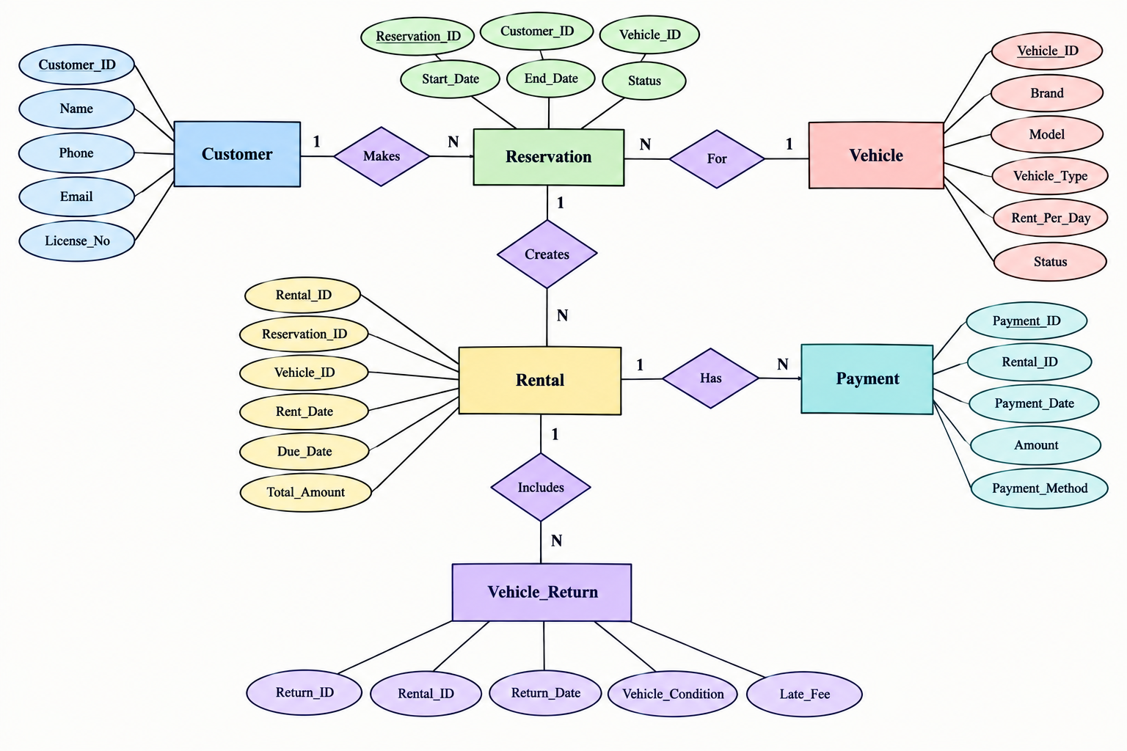

Slide 3
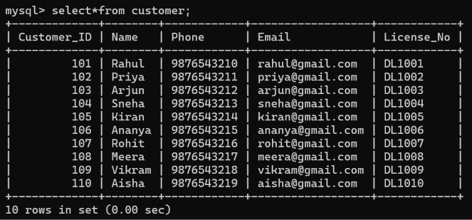
TABLES
CUSTOMER TABLE

Slide 4
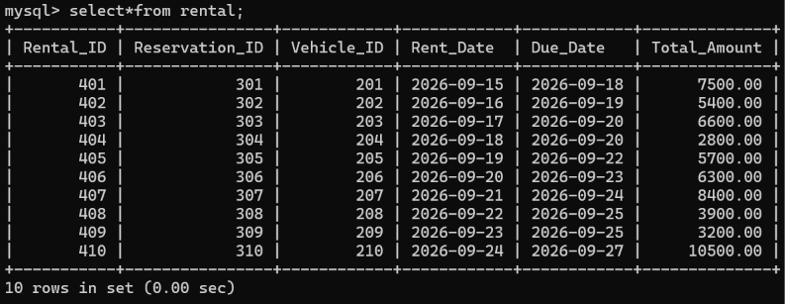
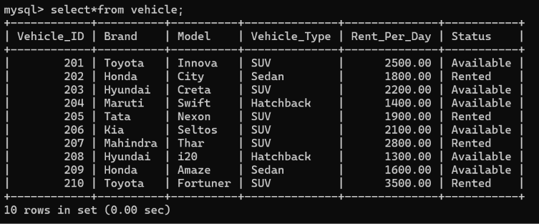
RENTAL DETAILES
VEHICLE TABLE

Slide 5
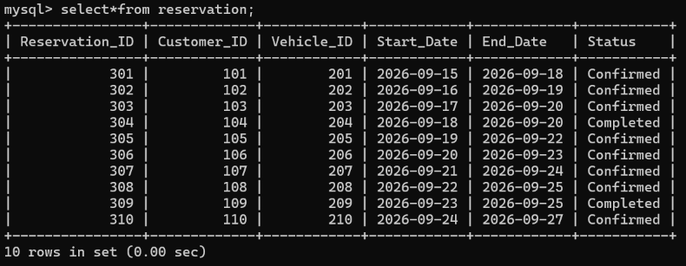
RESERVATION TABLE

Slide 6
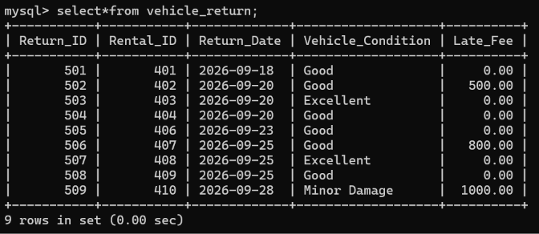
VEHICLE RETURN DETAILS

Slide 7
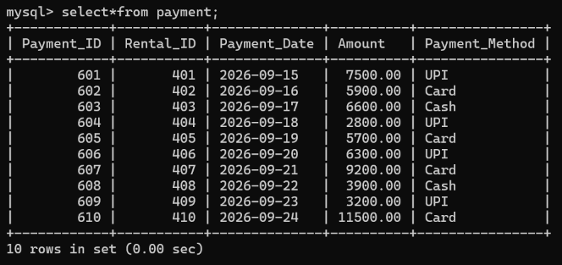
PAYMENT DETAILS

Slide 8
THANK YOU

